Slide 1
PuzzleHub Game Suite
PF Final Lab Project Report
By Muhammad Ali Shahzad
COMSATS University Islamabad

Slide 2
Project Introduction
PuzzleHub Game Suite is a collection of logic, math, and word-based games developed in the C programming language. It is designed to test and improve users’ problem-solving skills while maintaining engaging visuals and functionality. The project aims to provide a single interface for multiple games that are educational and entertaining

Slide 3
Key Features
- Multiple games: Sudoku, Tic Tac Toe, Wordle, Hangman, Anagram, Riddle, Math Solver
- User login system with multiple profile support
- Score saving and display system
- Leaderboard system using directory reading
- Colored UI using Windows console functions
- Menus with loading screens and time delays for better experience
- Simple graphics using characters for games like Tic Tac Toe and Hangman

Slide 4
Concepts Used
- Conditional statements (`if`, `switch`)
- Loops (`for`, `while`, `do-while`)
- Functions for modular code
- Arrays and strings for input handling and word storage
- Structures (`struct`) for representing users and scores
- File handling (`fopen`, `fscanf`, `fprintf`)
- Directory handling using `<dirent.h>`

Slide 5
How the Project Works
When the program runs, the user is prompted to log in or create a new profile. Upon login, they are presented with a main menu containing options to play games, view scores, see credits, or quit. Each game updates the user's score which is saved in a text file. The leaderboard function scans all score files and displays the highest scoring user for each game.

Slide 6
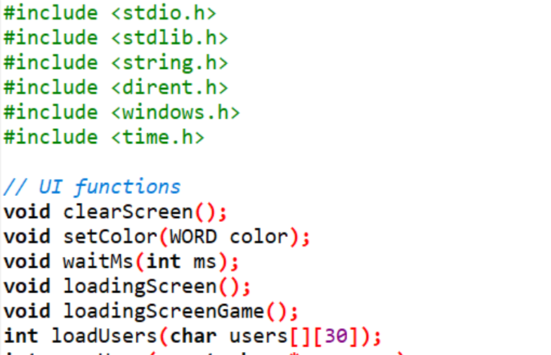
Challenges faced
Implementing file handling with multiple users and parsing the score data from text files accurately was challenging. Directory scanning using `<dirent.h>` and updating leaderboard data dynamically required careful string manipulation and condition handling.

Slide 7
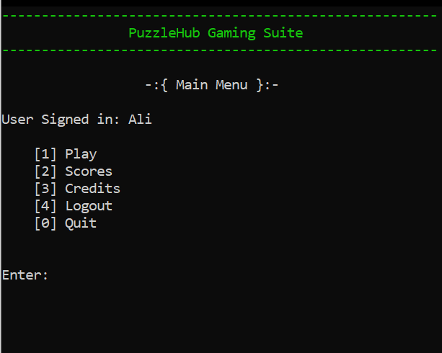
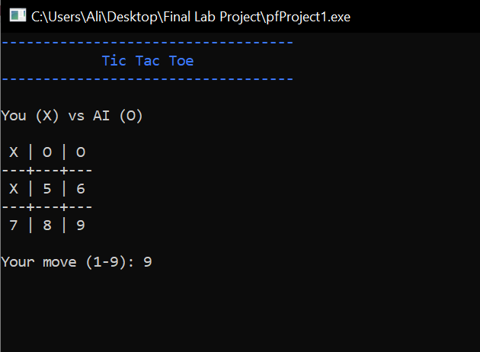
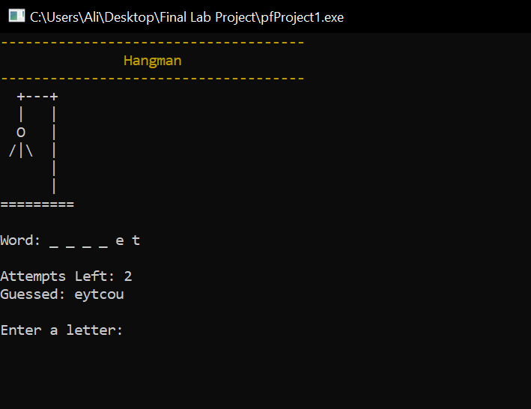
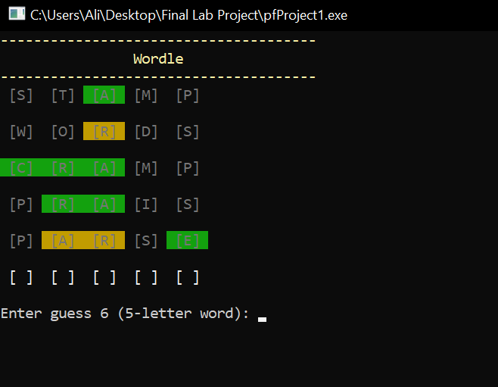
Sample Output

Slide 8
Conclusion
The PuzzleHub Game Suite project allowed me to consolidate several programming concepts into a single practical application. It not only strengthened my logic-building but also gave me a good experience of handling real-life features like user profiles, score saving, and directory operations. In future versions, graphical interfaces and additional games could be added.

